Slide 1


ICCI National Stakeholder Workshop on Childhood Cancer
21–22 May 2026, New Delhi
From Policy to Practice
-Tailoring Pediatric Oncology to Diverse State Ecosystems
Poonam Bagai
ICCI Governing Council
Founder Chairman, CanKids Kidscan
Survivor I Patient Advocate I Philanthropist

Slide 2

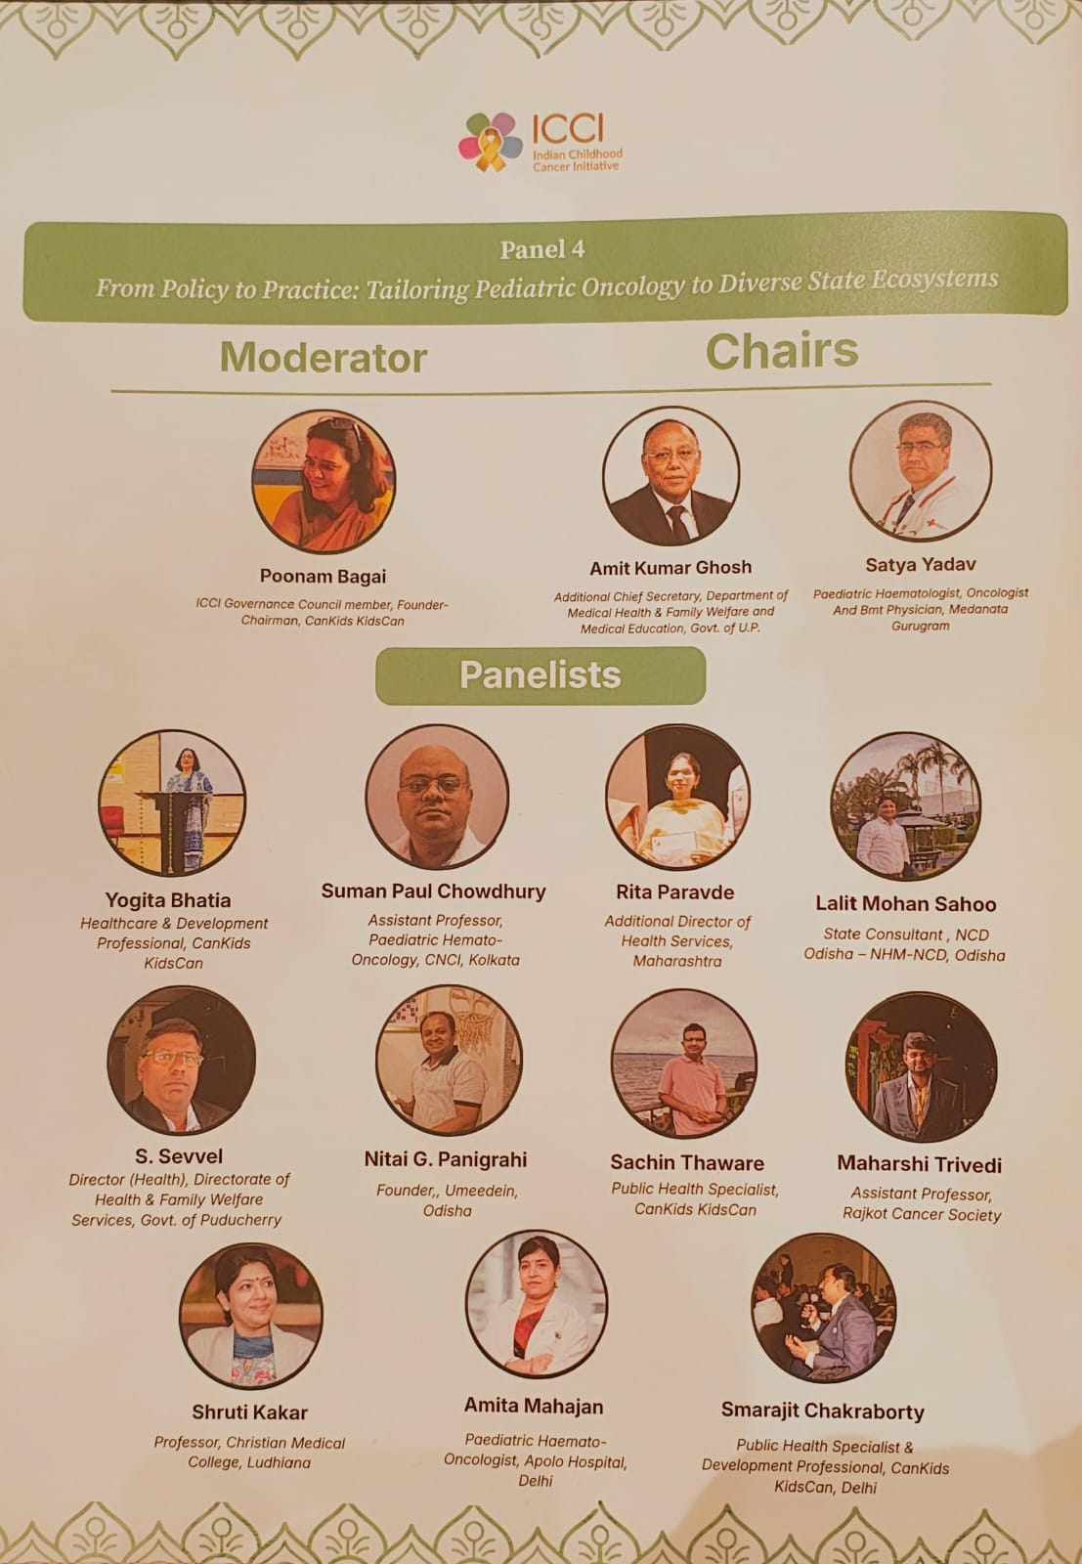

Slide 3
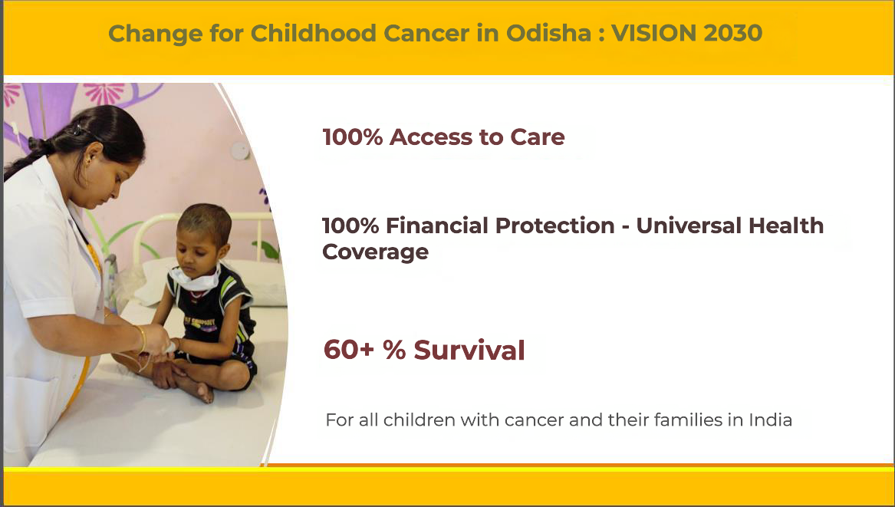
A Shared Vision: 100–100–60 – by 2030
Aligned to UNGA 80, WHO GICC and National and State Govt priorities.
Measured and monitored over time. An outcomes framework for all stakeholders

Slide 4
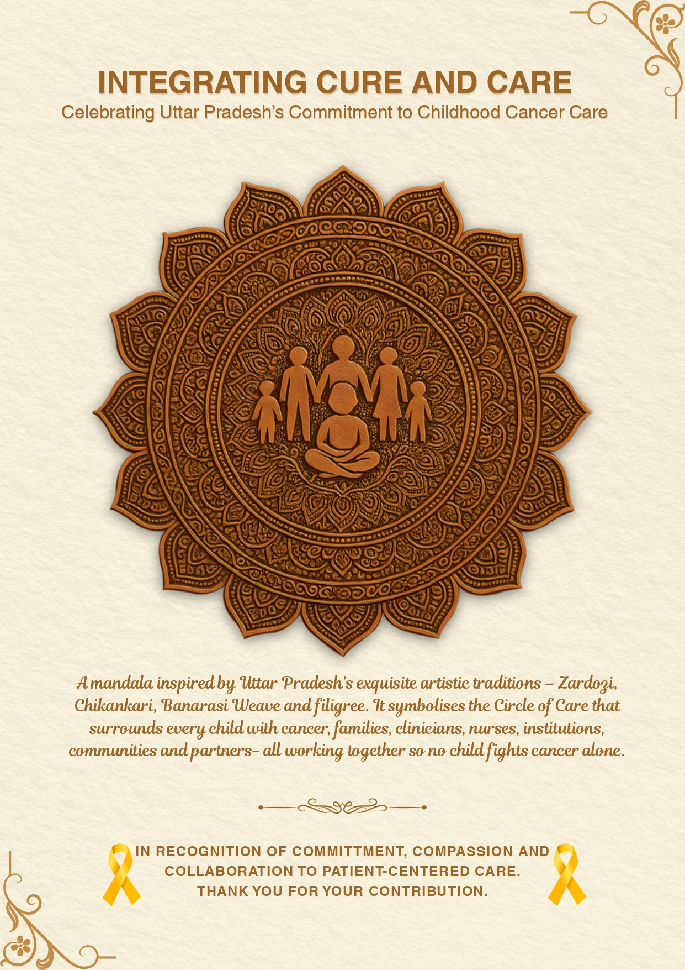
A mandala inspired by a State's exquisite artistic traditions - Zardozi, Chikankari, Banarasi Weave and filigree.
It symbolises the Circle of Care that surrounds every child with cancer,
families,
clinicians, nurses,
institutions,
communities and partners
all working together
so no child fights cancer alone.

Slide 5
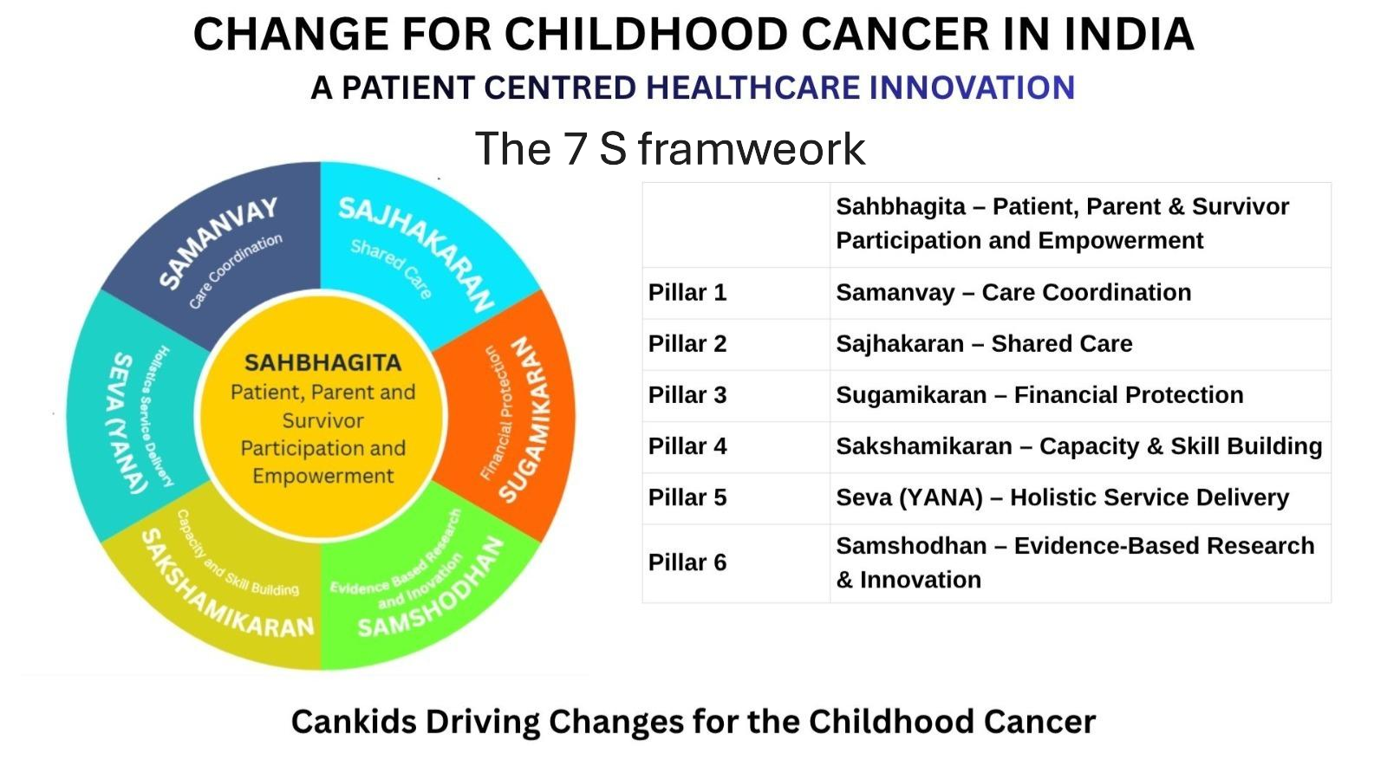
Adapted from the WHO CureALL Framework
and aligned with the standard pillars of Health Systems Strengthening
for integrated childhood cancer care

Slide 6

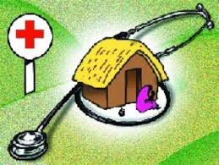

7S MODELS OF CCC STATES for CHILDHOOD CANCER CARE
District Hospital
Support throughout the journey from PHC/Grassroot Community level to Tertiary Cancer Center
Shared care &
Continuity of care at the home – palliative and survivorship
Providing
Access2Care,
Financial Protection and Survival Outcomes to Patients and Families

Slide 7
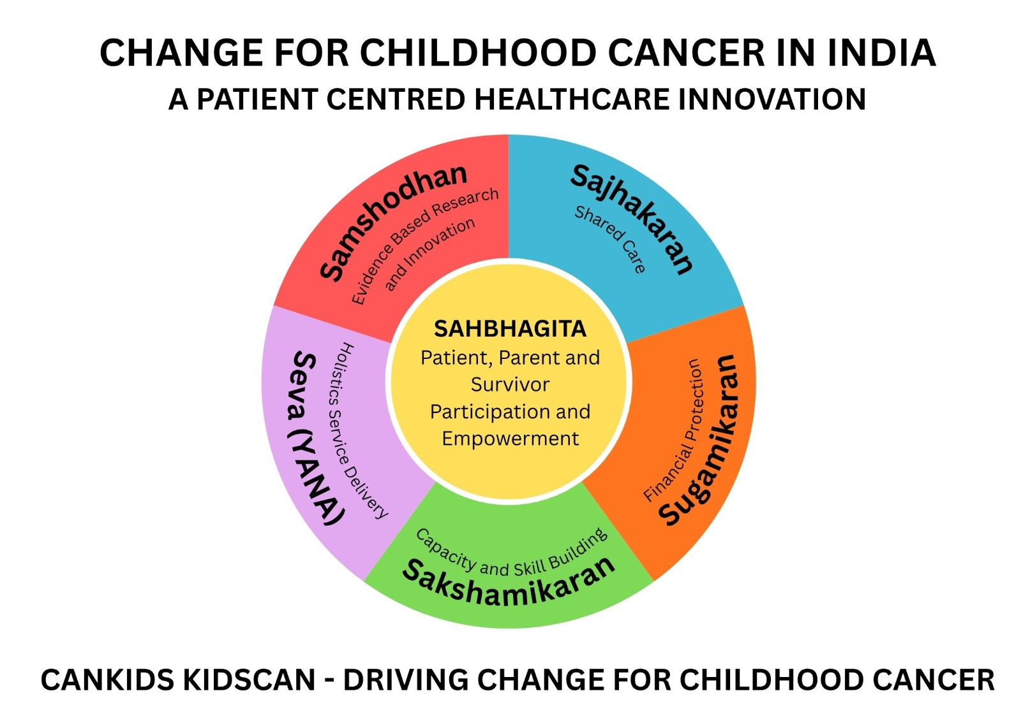
INTEGRATED FRAMEWORK – WORKING WITH ALL RELEVANT STAKEHOLDERS
Partnering with National Health Mission
Partnering with State Medical Education department
Partnering with ABDM, NHA
and State Health Authorities
Partnering with Hospital institutions and treating teams, professional bodies – IAP PHO, IAP, AIOS, InPHOG, NCG
Partnering with Community, Grassroot and other CSOs, Media, Donors

Slide 8
            1. Comprehensive Coordinated and Patient Centred Cancer Care for Childhood Cancer
Regular Mapping & Gap Analysis: Conduct periodic mapping of hospitals and diagnostic services to identify gaps and prioritize needs and to define Childhood Cancer Divisions CCDs
Development of Diagnostic Hubs, Centres of Excellence (CoEs), Hubs, Spokes Shared Care centres with agreed upon referral pathways - based on mapping and gap analysis and integrating into the State plans and programs - to ensure 100% access to care 100% financial protection within the state
District level sensitization and District Early intervention Program for Sajhakaran – Detect, Diagnose, Refer, Treat , Continuity of Care and Shared Care
Manpower, Training Capacity Building of HCWs, SSTs and PWLEs as structured programs
Capacity Building and strengthening of HCPs and Institutions, in Government Medical Colleges, District Hospitals, and District Day Care Chemo Centres through sustained advocacy , technical assistance and infrastructure/equipment support
Social Support Delivery of Service Continue providing social support across all Cancer Care Centres (CCDs) and scale up based on local demand and needs.
District Hospital

Slide 9
2. Proposed Terms of Reference of State Ped Onc Taskforce integrated in the Cancer Care Program & NCD Child in the State
Terms of Reference:
  Providing expert inputs into the further development and delivery of CC Project
  To make recommendation for health system strengthening
  To address Barriers and Solutions through SAJHAKARAN
  Convergence: Integrate CC plan in other government plan
  Identify and engage internal and external stakeholders that are needed for the successful implementation of childhood cancer services
  Integrate the CC Action Plan in PIP
  To monitor the progress against objectives every three months, using the key metrics decided as per action plan and suggest mid course corrective measures
  To make recommendations on action plan submitted to govts

Slide 10
3. Proposed State Teleconsultation & Tumor Board- STTB for Childhood Cancer
It is a multidisciplinary team that serves as an Expert body for Childhood Cancer in UP region , helpdesk
STTB will have various experts including:
a. Paediatric Oncologists from each State/UT and CCD,
b. Other specialists - Paediatric Surgeon / Surgical Oncologist, Radiation Oncologist, Radiologist, Pathologist, Paediatrician / Paediatric Haematologist,
c. Oncology nurses, Psychologist, Palliative care expert, Nutritionist, P2L Survivorship Faculty.
d. National/International Experts
Functioning –
WhatsApp group for Case discussions Accompanied with weekly Virtual Tumor Board sessions on Zoom
Quarterly meeting of the Expert body-
Helpdesk services and teleconsultation from District hospitals , Daycare Chemo centers Spokes and Shared care centers.

Slide 11
            4. Plan for District level awareness and information Dissemination
Awareness and information campaigns will be carried out across all districts of the State through multiple channels and platforms to reach the general public as well as grassroots health workers.
Awareness Activities to be conducted:
Informative sessions at health facilities and community platforms
Nukkad Nataks (street plays) to engage and educate the public in local languages
Distribution of printed materials including leaflets, posters, and resource directories
Webinars and virtual sessions targeted at health professionals staff and frontline workers
Annual Awareness Campaigns:
International Childhood Cancer Day (ICCD) – Celebrated every February 15
Retinoblastoma Awareness Week – Observed every third week of May
Childhood Cancer Survivor Day – Celebrated annually on the first Sunday of June
Childhood Cancer Awareness Month (CCAM) – Observed throughout the month of September
These initiatives aim to enhance public understanding, promote early detection, and ensure timely referral for children with cancer.

Slide 12
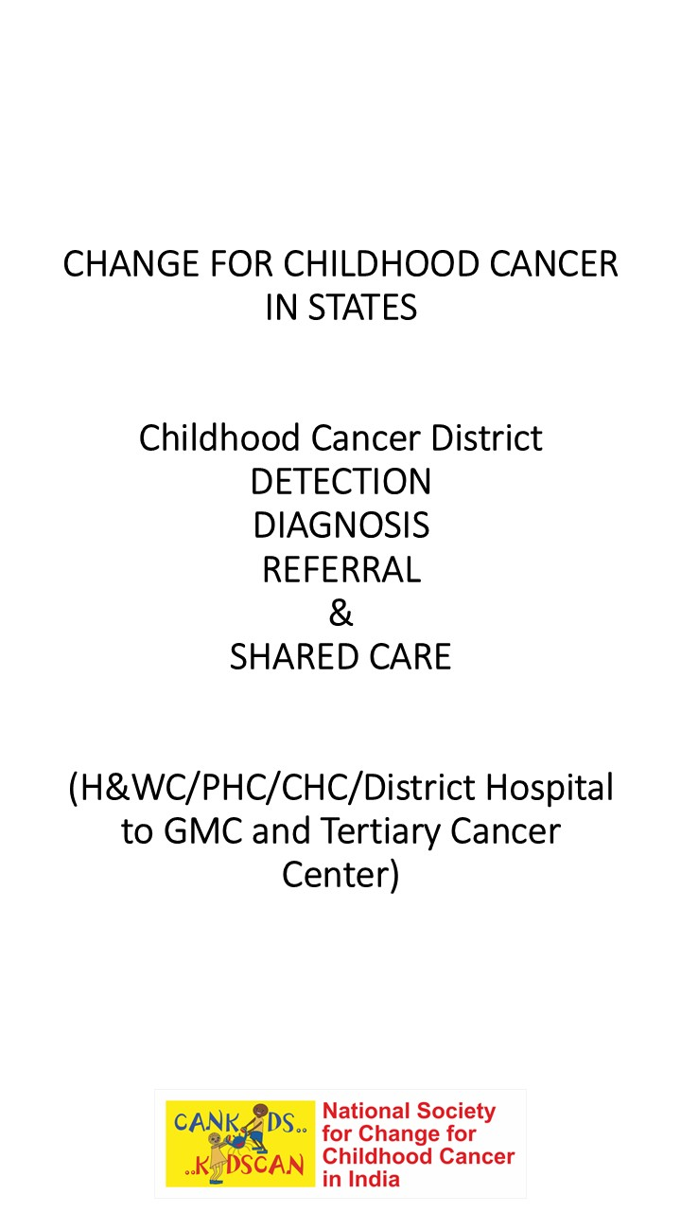
5. District Level Early Intervention Plan In States
State Govt Helpline
State/ Regional Care Center – SAMANVAY KENDRA
Chief Medical Officer/Asst. Chief Medical Officer at District Level
Social Support OPD
District Early Intervention Center
Cases Referral online
CaNourish Online
Cases Referral
District Hospital
CaNurture Online
DPPN
District Day Care Chemotherapy Center
Cases Referral
Community Hospitals
School/ Colleges
Panchayati Raj
Block Development Office
Organizational Network (ASHA/ Aanganbadi/RBSK)
DPPN
Building Rapport
Spreading Awareness

Slide 13
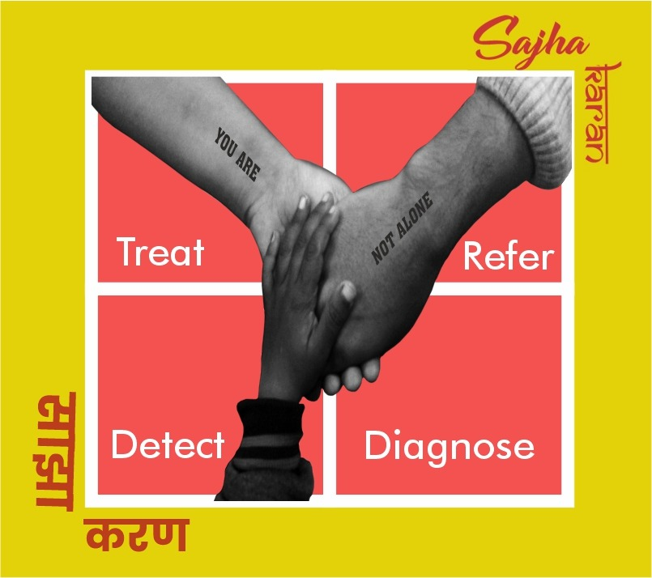
SAJHAKARAN
Model of Shared care Partnering with
National Health Mission
Department of Medical Education
Health and family Welfare
ABDM
CHIld Welfare
Education Ministry/Department
Hospitals treating childhood cancer
Professional Bodies – IAP, IAP PHO, MCI, ICMR
Source – UICC, available in vernaculars

Slide 14
Why State Ecosystems Matter
Where We Are Today
Presentation by Dr Haresh Gupta , Dy CEO and Chief of Programs, Cankids Kidscan

Slide 15
State Government Engagement Footprint
By May 2026, 14 states formally engaged through
MoUs or
structured stakeholder processes represent
This represents -
78% of India’s estimated childhood cancer incidence
A potential systems reach across 498 of India’s 807 districts
“Demonstrating how state-led ecosystems can accelerate progress toward 100% Access, 100% Financial Protection, and improved Survival.

Slide 16
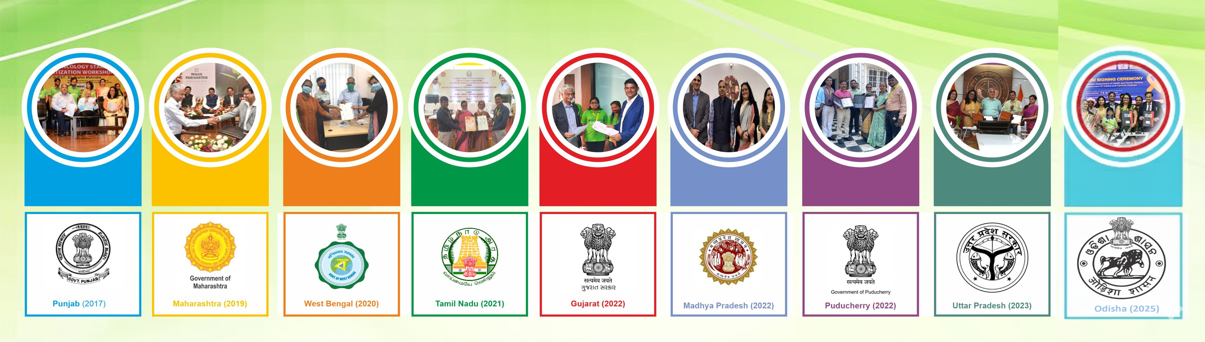
9 STATE GOVERNMENTS ALREADY SIGNED UP FOR CHANGE for CHILDHOOD CANCER
Prioritizing Childhood Cancer as a Child and Health Priority
*Incidence – 42616 (55.45%) of INDIA TOTAL and 10% of WORLD INCIDENCE
*1543
*6317
*5265
*3624
*3632
*4946
*62
*14700
*2493
MOUs with CanKids as Knowledge, Technical and Support Partners

Slide 17
Sn. | Name of State | Year of Signing MOU | Incidence (Estimated Burden) of Childhood Cancer)of State | Percentage | Access at Start(%) | Access as of March 2025 | District Reached | Hospital With CHSUs
1 | Punjab | 2017 | 1543 | 2% | 30% | 32% | 23 | 6
2 | Maharashtra | 2019 | 6317 | 8.22% | 49% | 65% | 36 | 24
3 | West Bengal | 2020 | 5265 | 6.85% | 32% | 71% | 30 | 11
4 | Tamil Nadu | 2021 | 3624 | 4.71% | 63% | 76% | 38 | 14
5 | Gujarat | 2022 | 3666 | 4.77% | 45% | 57% | 33 | 8
6 | Madhya Pradesh | 2022 | 4946 | 8.62% | 26% | 46% | 57 | 9
7 | Puducherry | 2022 | 62 | 0.08% | 63% | 68% | 4 | 1
8 | Uttarpradesh | 2023 | 14700 | 19.13% | 28% | 47% | 75 | 11
9 | Odisha | 2025 | 2493 | 3.24% | 22% | 52% | 30 | 4
 | Sub Total |  | 42616 | 55% | 40% | 54% | 319 | 88
10 | Karnataka(MOU requested) | 2025 | 3405 | 4.43% | 22% | 70% | 31 | 9
11 | Bihar (MOU requested) | 2025 | 7976 | 10.38% | 25% | 52% | 38 | 3
12 | Tripura (MOU requested) | 2025 | 214 | 0.27% | 24% | 47% | 8 | 0
13 | Haryana ( letter being submitted) | 2026 Q3 | 1590 | 2.07% |  | 46% | 22 | 2
14 | Himachal Pradesh ( letter being submitted) | 2026 Q3 | 376 | 0.49% |  | 32% | 12 | 1
13 | Chhattisgarh(ICCI Workshop) | Apr-26 | 1680 | 2.19% |  | 33% | 33 | 0
14 | Assam (ICCI Workshop) | May-26 | 2075 | 2.70% | 23% | 52% | 35 | 4
 | Subtotal |  | 17316 | 22.55% |  | 47% | 179 | 19
 | Total for 2026 |  | 59932 | 78% |  |  | 498 | 107
By 2026 – 78% incidence
Where We Are Today - May 2026

Slide 18
Hospital Mapping
Region | Mapped 26-27 | Treating Children
East | 104 | 85
North | 398 | 252
South | 209 | 116
West | 257 | 174
Grand Total | 968 | 627
968 hospitals mapped across India, State wise- cancer facilities'/Medical colleges referring children
627 hospitals treating /referring childhood cancer
Hospitals by Patient Load
Hospitals by Type
Category | North | East | West | South | Pan India | % of Total
> 300 | 15 | 6 | 6 | 6 | 33 | 5%
150-299 | 24 | 9 | 11 | 16 | 60 | 10%
100-149 | 15 | 9 | 13 | 18 | 55 | 9%
50-99 | 39 | 21 | 18 | 33 | 111 | 18%
30-49 | 30 | 12 | 30 | 19 | 91 | 15%
<30 | 129 | 28 | 96 | 24 | 277 | 44%
Total | 252 | 85 | 174 | 116 | 627 | 100%
Type of Hospital | North | East | West | South | Pan India | % of Total
Government | 106 | 34 | 25 | 28 | 193 | 31%
Private | 138 | 39 | 115 | 73 | 365 | 58%
Trust | 8 | 12 | 34 | 15 | 69 | 11%
Total | 252 | 85 | 174 | 116 | 627 | 100%
Where We Are Today - May 2026
Bi annually the State Care Coordination Center undertakes a comprehensive survey and mapping on present status of Pediatric Oncology services in the state. All hospitals in the state are mapped to seek any information about children being treated for cancer. This is through telephonic conversations, visits and feasibility reports . This also helps to identify current centres and those that need to be developed as PCUs and COEs.

Slide 19
State Government Engagement Expansion by 2030
Expansion across remaining high-burden and underserved states
Progressive integration of Childhood Cancer Divisions/Districts (CCDDs), Samanvay Kendras, and referral ecosystems
Building toward:
  100% national incidence coverage
  Potential reach across all districts of India
  A nationwide integrated childhood cancer ecosystem
.
2030 Goal : Every child with cancer — regardless of geography — connected to systems for detection, referral, treatment, financial protection, survivorship, and continuity of care

Slide 20
Table 3 : Childhood Cancer District Outreach Frame Work for Early Detection and Diagnosis – Sajhakaran
Block | Category | States/Uts | Estimated Burden of Childhood Cancer | % of total incidence | No.of Districts | % of India's 806 Districts | Status Summary
Block 1 | Formal State Partnership | Punjab, Tamil Nadu, Gujarat, Maharashtra, West Bengal, Madhya Pradesh, Uttar Pradesh, Puducherry, Odisha | 42616 | 55% | 319 | 40% | Formal MOU with State Govts/Departments of Health or Education, active Samanvay Kendras & Mapped Hospitals
Block 2 | Working Towards Formal Engagement Samanvay Kendras- | Karnataka, Bihar, Tripura, Haryana and Himachal, Chattisgarh and Assam | 17316 | 23% | 179 | 22% | formal MoUs in progress. Operational Samanvay Kendras,
Block3 | Programatic Presence | Jammu & Kashmir, Delhi,Chandigarh ,Goa, Telengana, Kerala, Uttrakhand, Rajasthan | 9134 | 12% | 153 | 19% | No formal Govt engagement yet ; Direct Services, hospital Partnerships, outreach, data mapping,
Block 4 | Future Expansion (Not Yet Reached) | Andhra Pradesh, Arunachal Pradesh, Jharkhand, Manipur, Meghalaya, Mizoram. Nagaland,Sikkim, Dadar & Nagar Haveli,Daman Diu, Lakshwadeep,Laddak,Adman & Nicobar | 7739 | 10% | 156 | 19% | Planned 2026-30 expansion under CCC India and Canshala for life project
 | Total (National Coverage Framework by 2030 | 36 States/Uts | 76805 |  | 807 | 100% | National Coverage Framework by CanKids KidsCan
Where We Are Today - May 2026

Slide 21
Why State Ecosystems Matter
India cannot rely on one uniform childhood cancer model
States differ in geography, referral systems, workforce and financial protection
Integrated state ecosystems are essential for equitable access and survival
The future lies in convergence-based, patient-centred systems

Slide 22
State Ecosystem Typologies
1. LARGE DECENTRALISED STATES
2. STATES WITH CONCENTRAATION OR ONE APEX CANCER CENTRE
3. REGIONAL REFERRAL & SHARED CARE ECOSYSTEMS
DIFFERENT PATHWAYS. SHARED GOALS.

Slide 23
CCDs (Childhood Cancer Divisions) Aligned to State Health Architecture
Large and high-burden states cannot be effectively managed through a single tertiary centre model alone.
The CCC State Model therefore proposes Childhood Cancer Divisions (CCDs) aligned with existing regional health and administrative architectures.
Why CCDs Matter
Reduce geographic inequity and travel burden
Improve early detection, referral, and continuity of care
Enable regional hub–spoke systems closer to families
Strengthen integration with NHM, Medical Education, and district health systems
Facilitate data, mapping, planning, and accountability at sub-state level
Key principle
Large states require decentralized CCD-based ecosystems, not single-centre models.
Large and high burden States –
UP, Bihar, Maharashtra, MP, West Bengal
Key Takeaways - Care must move closer to children and families* Shared care and continuity of care are essential* Apex centres should anchor regional networks* CCDs enable equitable access across large geographies* Integrated state ecosystems are critical for improving survival outcomes

Slide 24
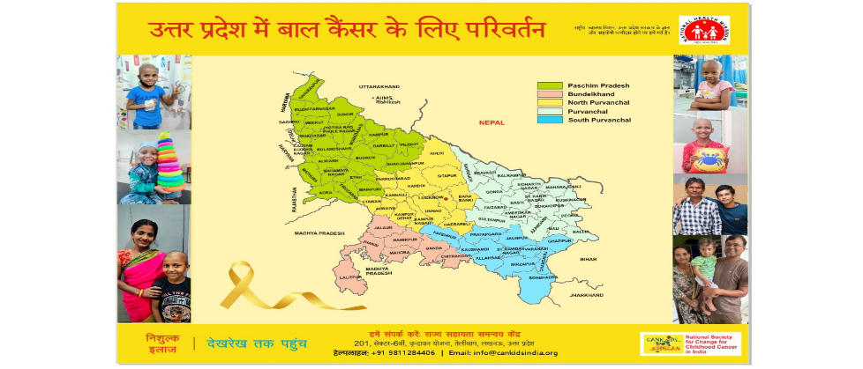
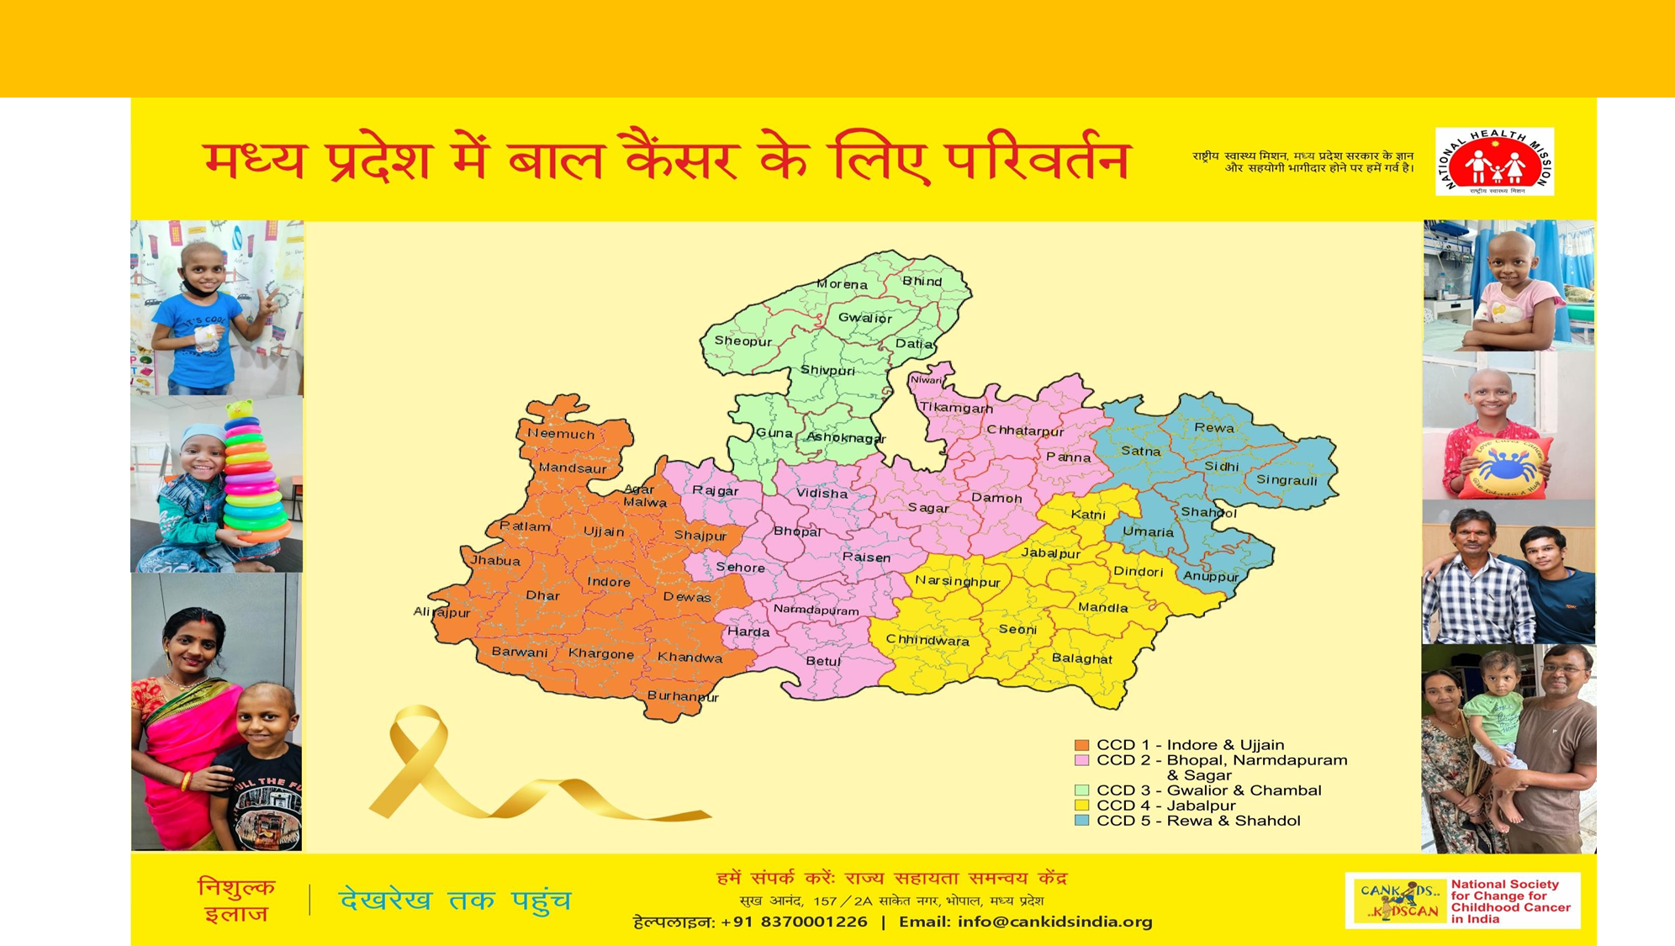
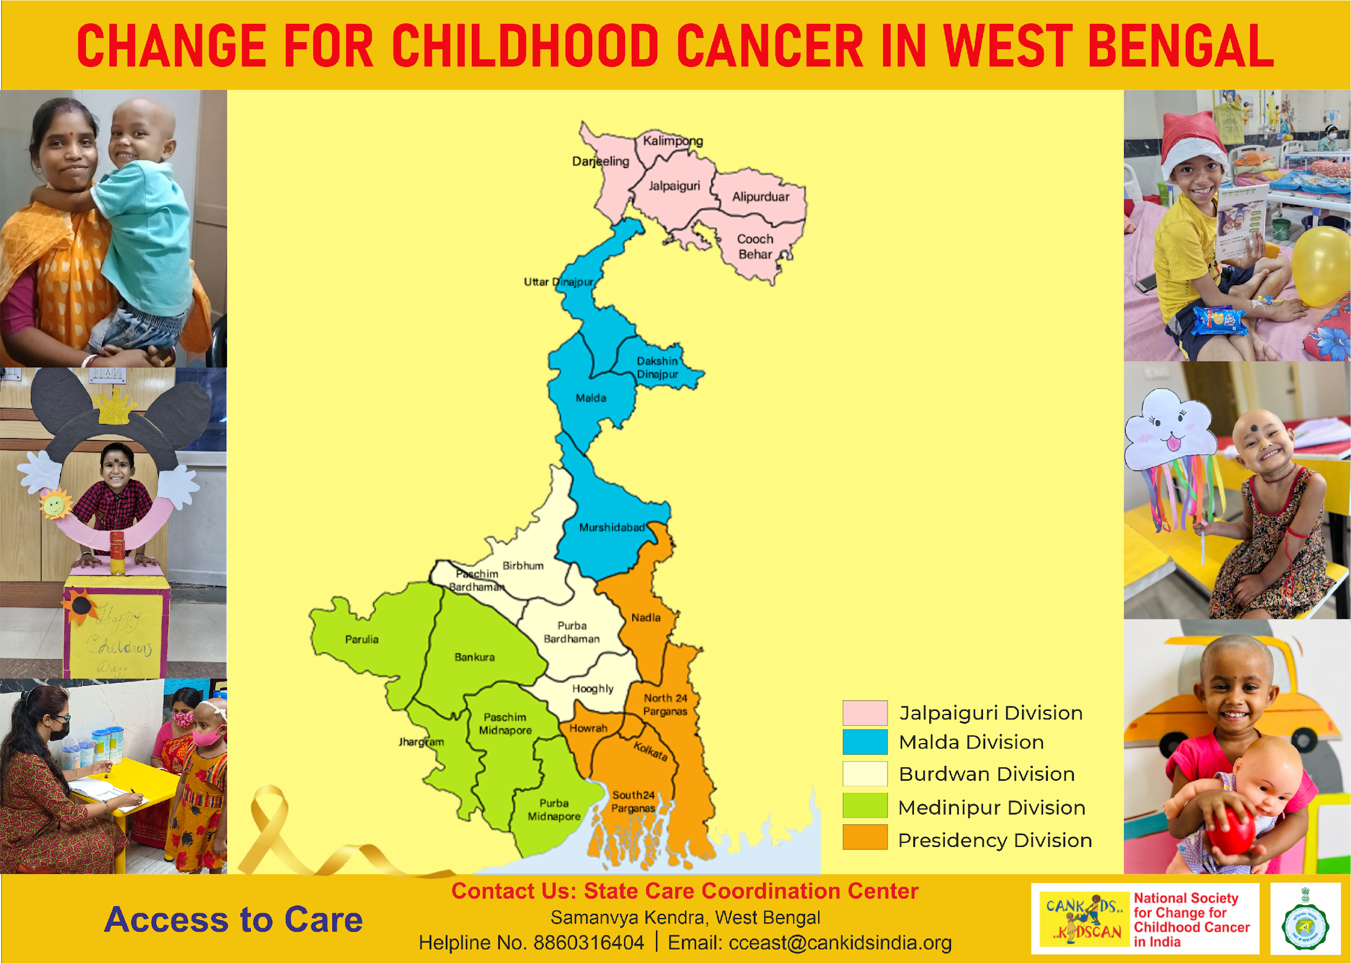
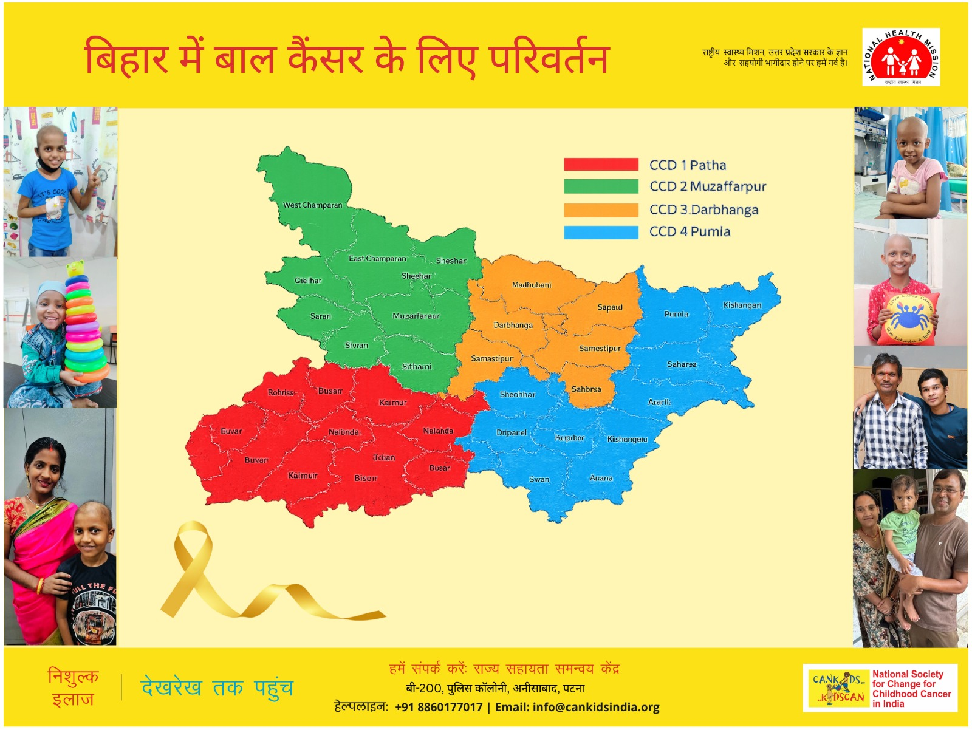
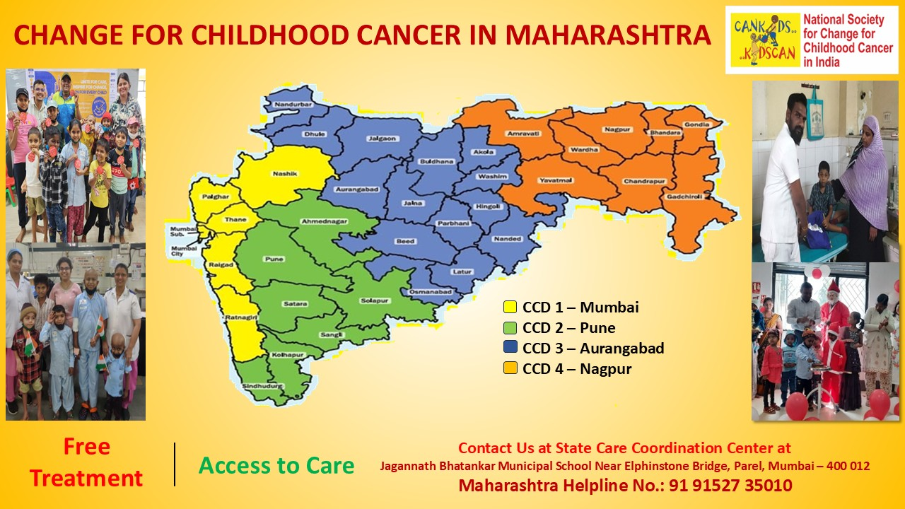
Large States – Decentralised Care
UP
MP
Incidence- 4946, Access to care- 2256 (46%)
Incidence- 14700, Access to care- 6963 (47%)
West Bengal
Bihar
Maharashtra
Incidence- 7976 , Access to care- 4169 (52%)
Incidence- 6317, Access to care- 4129 (65%)
Incidence- 5265, Access to care- 3743 (71%)

Slide 25
Uttar Pradesh – Demonstration Model
4 Childhood Cancer District Hubs
State Task Force under Cancer Care
STTB concept
PM-JAY and NHM integration
Presentation by Yogita Bhatia Sr State Coordinator
Project CCC UP Uttarakhand Project

Slide 26
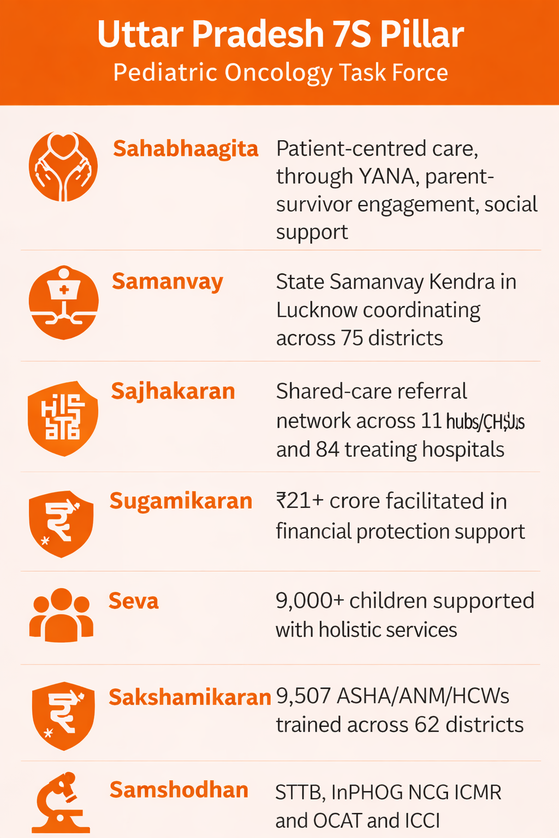
Uttar Pradesh as a Proof of Concept for the CCC India 7S Model |
From Fragmented Care to Statewide Integration
Why Uttar Pradesh Matters
India’s highest estimated childhood cancer burden: ~14,700 children annually – 4% of world’s incidence – 19% of India incidence
Access to care improved from 28% → 54% between 2019–2026
Formal MoU with Government/NHM framework since 2023
Demonstrates how the WHO CureAll framework + Health Systems Strengthening can be operationalized at state level through the CCC India 7S Model.
The 7S Integrated State Model in Action Key Message:
UP demonstrates that childhood cancer can be integrated into public systems using a stakeholder-led, government-aligned, patient-centred approach.

Slide 27
Building the Uttar Pradesh Childhood Cancer Network
A Hub–Spoke Shared Care Ecosystem
Key System Enablers
Pediatric Cancer State Task Force
State Samanvay Kendra – Care Coordination Center
Proposed State Tumor & Teleconsultation Board
District awareness & referral pathways
District hospitals and DCCC integration
HCW capacity building
Continuity of care closer to home
Impact
52% access already achieved
Roadmap to 100% Access by 2030
Reduction in treatment abandonment
Improved navigation and financial protection
Better continuity and survivorship care
Statewide System Architecture
4 Childhood Cancer Divisions (CCDs)
Lucknow / Awadh–Bundelkhand
Varanasi / South Purvanchal
Gautam Buddha Nagar / West UP
Gorakhpur / North Purvanchal
Network Strength
84 hospitals treating childhood cancer mapped
11 formal hub/CHSU institutions
Partnerships across:
  Government medical colleges
  Trust hospitals
  Private institutions
  NGOs and CSOs
  NHM and Health Department
  Pediatric oncology professionals
Shared Care Model
Detection → Diagnosis → Referral → Treatment → Shared Care → Survivorship/Palliative Care

Slide 28
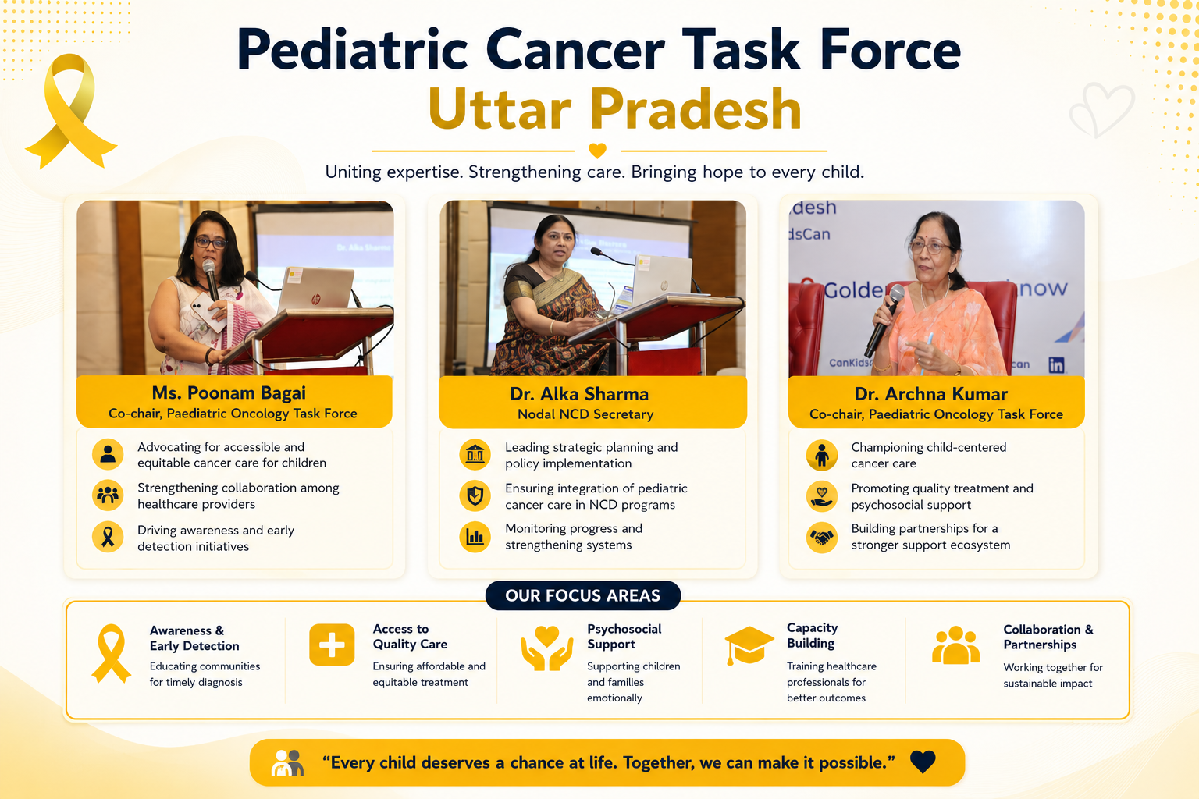

Slide 29
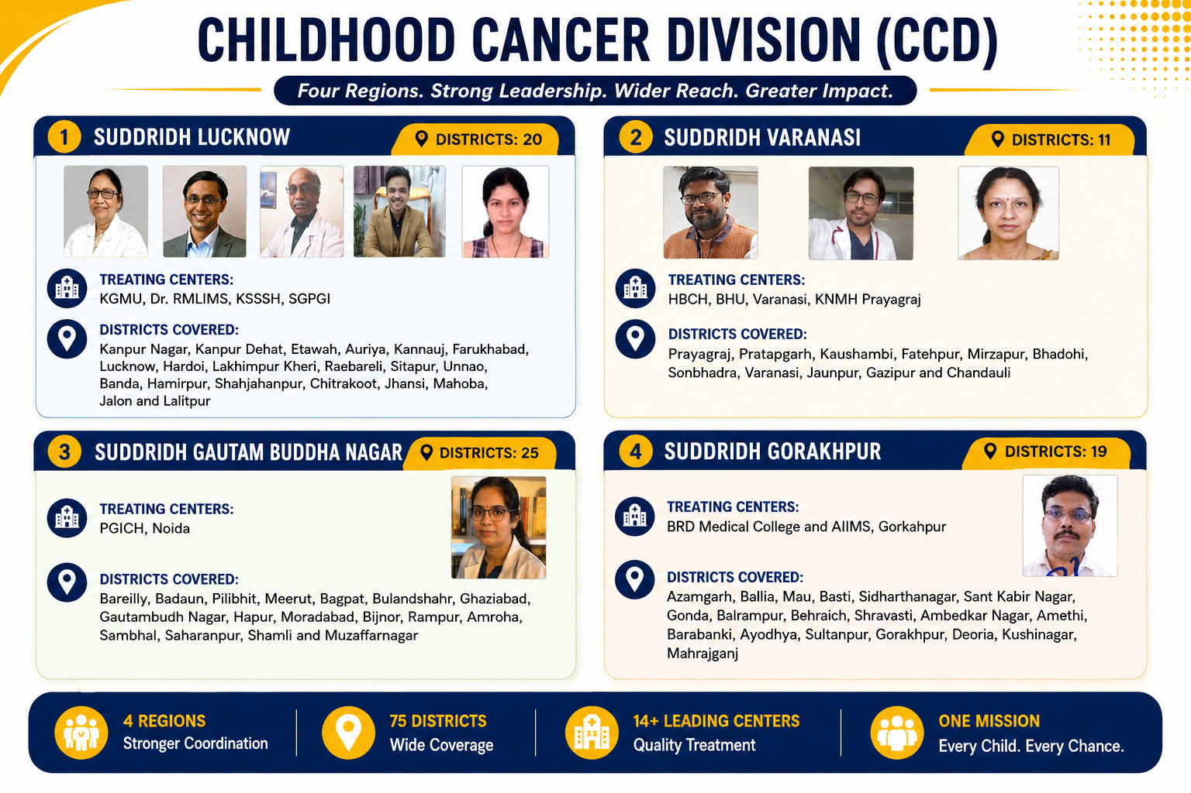
STTB + Childhood Cancer Division (CCD)
Divisions

Slide 30





Measurable Outcomes & Systems Change | From Pilot Interventions to Statewide Strengthening
Measurable Impact - Uttar Pradesh Childhood Cancer Integration
Why UP is a National Demonstration Model
From Fragmented Care to Statewide Integration
✓
Government-aligned
ACCESS TO CARE
✓
Scalable
7,600+
✓
Children accessing care annually
✓
Public–Private–Civil Society partnership driven
CAPACITY BUILDING
✓
Outcome-oriented
9,507 HCWs
Trained in 62 districts
✓
Integrated with WHO CureAll & UHC goals
✓
FINANCIAL PROTECTION
21+ Crore
✓
Replicable across other Indian states
Facilitated
EVIDENCE & INNOVATION
KEY TAKEAWAY
Annual Reviews
Mapping & OCAT reviews
Uttar Pradesh demonstrates that "Change for Childhood Cancer" is achievable through coordinated systems strengthening — not parallel programs.
HOLISTIC CARE
1,800+ Families
Supported - "Home Away from Home"
Uttar Pradesh demonstrates that "Change for Childhood Cancer" is possible through coordinated systems strengthening.

Slide 31
Moderator Questions – Large States
Question for Mr. Amit Kumar Ghosh, ACS Uttar Pradesh
• How can large states decentralise access without compromising quality?
Question for Dr Rita Paravde, Maharashtra:
• What lessons has Maharashtra learned in embedding childhood cancer into public health systems?
Question for Dr Suman Paul Chowdhury, West Bengal:
• What challenges emerge when tertiary centres become regional referral hubs sometimes by default?

Slide 32
States with concentration, one Major Government, or Cancer Centre
ODISHA, GUJARAT, KARNATAKA, PUDUCHERRY
EXPANDING ACCESS BEYOND ONE OR TWO CITIES
REGIONALISATION AND OUTREACH
CONTINUITY OF CARE CLOSER TO HOME
PM-JAY and NHM integration
PRESENTATION BY
DR SACHIN TAWARE, Regional Head – Maharastra, Madhya Pradesh, Gujarat, Goa

Slide 33
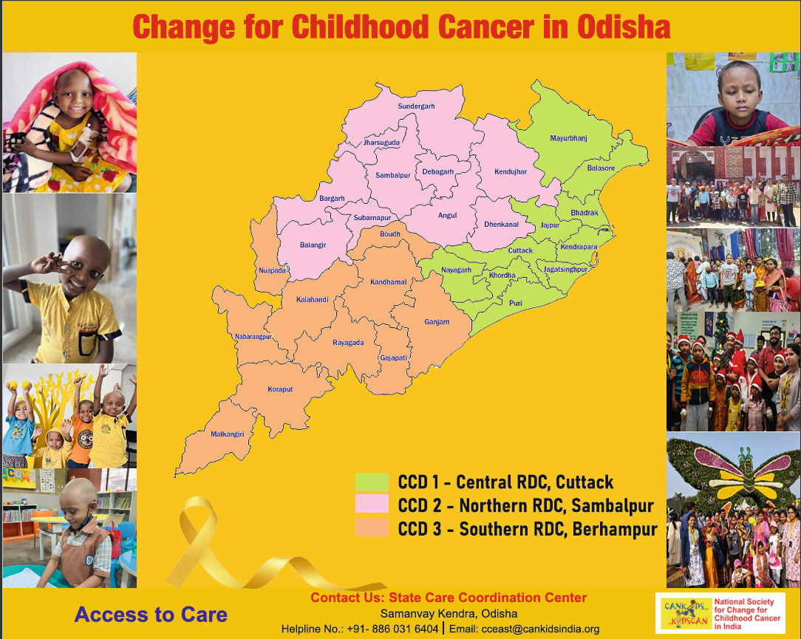
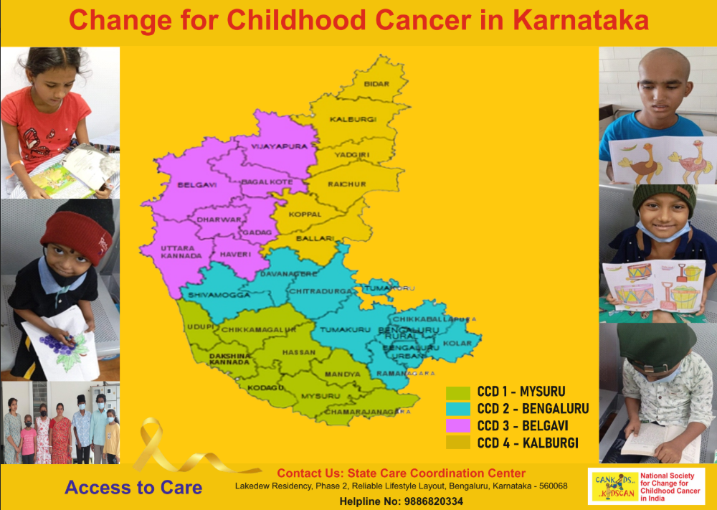
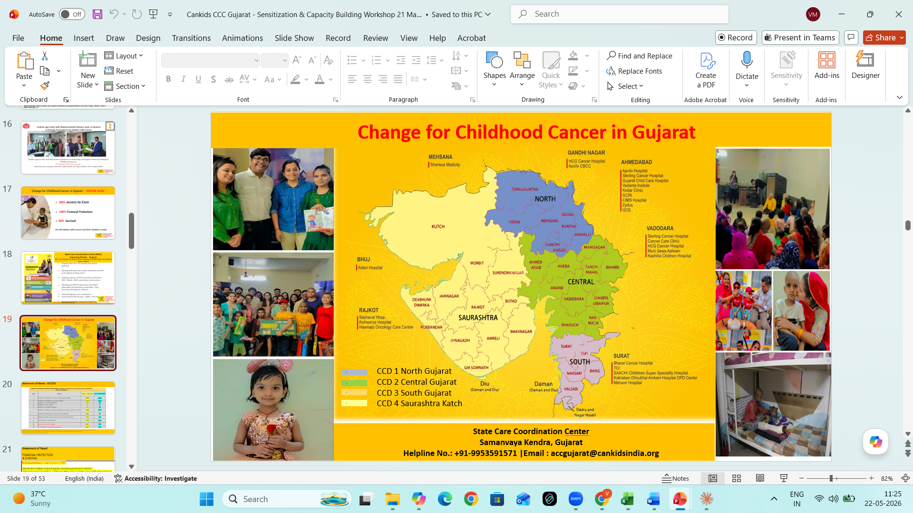
States with Concentrated/ One Major Cancer Centre
Odisha
Karnataka
Gujarat
Incidence- 2493, Access to care- 1290 (51%)
Incidence- 3405, Access to care- 2371 (70%)
Incidence- 3666, Access to care- 2094 (58%)
Pediatric Oncology services currently only in Central CCD – Bhubaneshwar and Cuttack
- 100% of children accessing care 52% of total incidence
Pediatric Oncology services – Kidwai Memorial and Indira Gandhi ICH in Bengaluru
- 28% of children accessing care and 20 % of total incidence
Govt Pediatric Oncology services through GCRI only
– 45% of children accessing care and 29% of total incidence

Slide 34
Moderator Questions – Apex Center States
Question for Dr Lalit Mohan Sahoo, Odisha
What are Odisha’s priorities for expanding access across the state?
Question for Dr S. Sevvel, Puducherry/ Nitai Panigrahi, Umeedein
Can smaller states become innovation laboratories for integrated childhood cancer care?
Question for Dr Maharshi Trivedi, Gujarat
How can centres of excellence evolve into state-wide network leaders?

Slide 35
Shared Care Across State Borders
Delhi supporting UP & Bihar
West Bengal supporting North-East India
Chandigarh supporting Punjab & adjoining states
Mumbai supporting neighbouring states
Presentation by Dr Shruti Kakar

Slide 36
Regional Referral Ecosystems Require Cross-Border Coordination
Several states and tertiary centres serve large numbers of children from neighboring states due to gaps in pediatric oncology capacity and access
Key System Needs
Strong patient navigation and care coordination systems
Cross-border referral and shared-care pathways
Financial protection portability (“schemes should follow the child”
Interstate continuity of care for survivorship and palliative care
Coordination between Central Government, State Governments, NHM, PM-JAY, and tertiary centres
CCC India Approach
Regional CCD ecosystems + Samanvay Kendras + Shared Care + Interstate Coordination
Key principle
Some states / institutions function as national/ regional childhood cancer ecosystems for India and require integrated interstate planning and coordination.
States Serving Adjoining States
Key Takeaways - Some states and institutions effectively function as national or regional pediatric cancer hubs, so policy and planning should support integrated interstate pediatric oncology networks, not isolated state-based systems.

Slide 37
Moderator Questions – Shared Care Ecosystems
Question for Dr Amita Mahajan, Delhi:
What mechanisms are needed for interstate continuity of care?
Question for Dr Meshram, Chhattisgarh:
What support systems are most critical for interstate referral pathways?
Question for Dr Smarajit Chakraborty:
How do we build regional ecosystems beyond treatment delivery alone?

Slide 38
Towards Integrated Childhood Cancer Ecosystems
Government + NHM + PM-JAY
Tertiary Centres + Shared Care Networks
Civil Society + Survivor Voices
Data Systems + Dashboards
Integrated ecosystems for every child

Slide 39
ICCI National Stakeholder Workshop on Childhood Cancer
Different States. Shared Goals.
100% Access
100% Financial Protection
60% Survival
Thank You

